Slide 1
Veteran and Active Duty Military Men and Women Mental Health Program
By: Darya Kovtun, Sijia Wang, Lucas Cavalier, Darielle Connor, and Taylor Walsh

Slide 2
Scope of the Problem
Key indicators of poor mental health in the veteran and active duty service men and women community:
Suicide
PTSD
Transitioning to civilian life

Slide 3
Notes:
Do 22 pushups every day for 22 days in order to support Active Heroes, who commit suicide. According to VA, it was reported that 22.2% of suicides are committed by veterans.
https://www.va.gov/opa/docs/Suicide-Data-Report-2012-final.pdf

Slide 4
Suicide

Slide 5
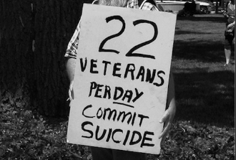
Notes:
When looking at death certificates, in 2010, the “Veterans comprised approximately 22.2% of all suicides reported during the project period” (VA). This number has dropped by 3% since 1999.
https://www.va.gov/opa/docs/Suicide-Data-Report-2012-final.pdf

Slide 6
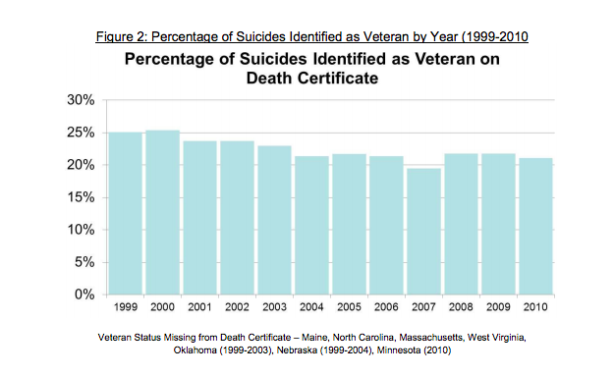
Notes:
https://www.va.gov/opa/docs/Suicide-Data-Report-2012-final.pdf
Key points:
The suicide rate in 2010 among veterans that was reported based on the death certificates is slightly over 20%. Figure 2, shows that the suicide rates did decline since 1999-2003. And ever since, the suicide rates have remained constant, with 2007 had the lowest suicide rate.

Slide 7
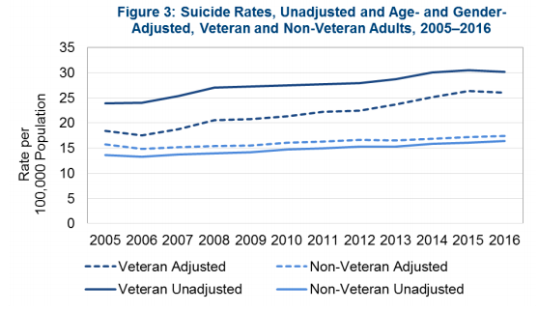
Notes:
Key Takeaways:
“From 2015 to 2016, the Veteran suicide rate decreased from 30.5 per 100,000 to 30.1 per 100,000.”
“Suicide rates for Veteran and non-Veteran adults increased from 2005 to 2016.”
“In 2016, the suicide rate was 1.5 times greater for Veterans than for non-Veteran adults, after adjusting for age and gender.”
https://www.mentalhealth.va.gov/docs/data-sheets/OMHSP_National_Suicide_Data_Report_2005-2016_508.pdf

Slide 8
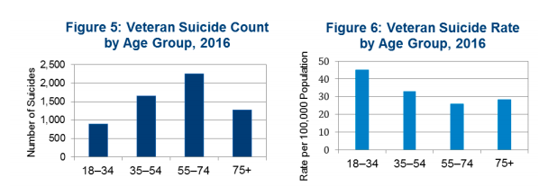
Notes:
The suicide rate per 100,000 people for Veterans aged 18-34 is the highest in 2016.
Whereas the suicide count is highest among 55-74 year old.
https://www.mentalhealth.va.gov/docs/data-sheets/OMHSP_National_Suicide_Data_Report_2005-2016_508.pdf

Slide 9
PTSD

Slide 10
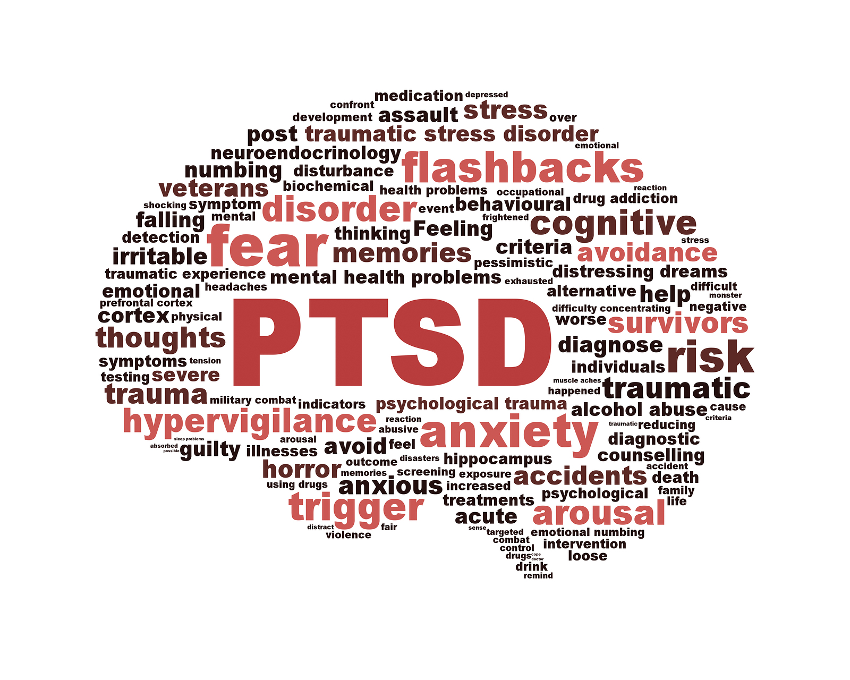
What is Posttraumatic Stress Disorder (PTSD)?
“PTSD (posttraumatic stress disorder) is a mental health problem that some people develop after experiencing or witnessing a life-threatening event, like combat, a natural disaster, a car accident, or sexual assault” (VA)
Notes:
https://www.ptsd.va.gov/understand/what/ptsd_basics.asp

Slide 11
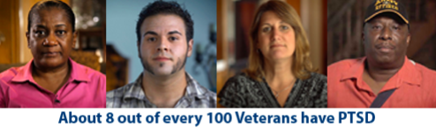
US Department of Veterans Affairs
Notes:
https://www.ptsd.va.gov/

Slide 12
How common is PTSD among Veterans?
PTSD varies by the area in which the veteran has served:
Operations Iraqi Freedom (OIF) and Enduring Freedom (OEF)
Gulf war (Desert Storm)
Vietnam War
Notes:
https://www.ptsd.va.gov/understand/common/common_veterans.asp
~11- 20 out of every 100 Veterans were diagnosed with PTSD
~12 out of every 100 veterans were diagnosed with PTSD
~15 out of every 100 in 1980s. National Vietnam Veterans Readjustment Study (NVVRS) have estimated this number to be 30 out of every 100 Vietnam Veterans

Slide 13
Operations Iraqi Freedom (OIF) and Enduring Freedom (OEF):
Approximately 11 to 20 of every 100 Veterans were diagnosed with PTSD
Notes:
https://www.ptsd.va.gov/understand/common/common_veterans.asp

Slide 14
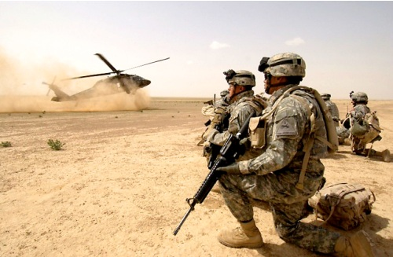
Gulf war (Desert Storm):
Approximately 12 out of every 100 veterans were diagnosed with PTSD
Notes:
https://www.ptsd.va.gov/understand/common/common_veterans.asp

Slide 15
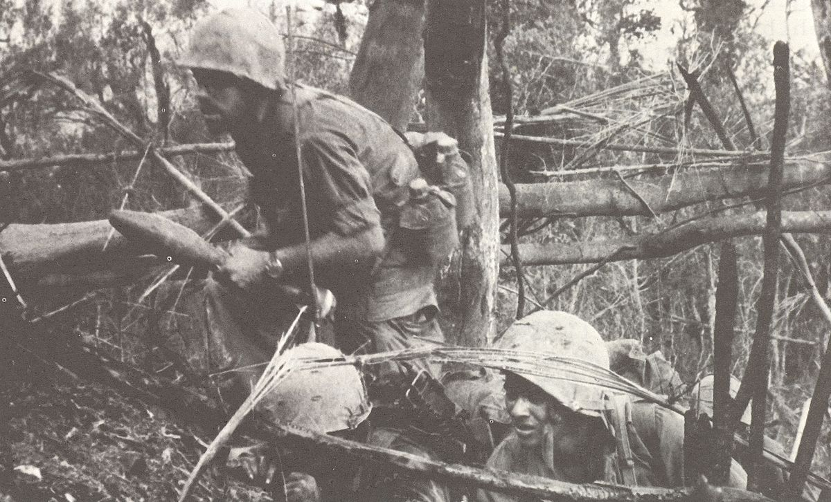
Vietnam War
Approximately 15 out of every 100 veterans were diagnosed with PTSD in 1980s. National Vietnam Veterans Readjustment Study (NVVRS) have estimated this number to be 30 out of every 100 Vietnam Veterans
Notes:
https://www.ptsd.va.gov/understand/common/common_veterans.asp

Slide 16
How to help veterans with PTSD get needed care?
Current Interventions:
Coaching into Care program helps family and friends of veterans who is suffering from PTSD to help their loved one.
Arranges a specialist to speak with the veteran and answer any questions and/or provides information to questions
888-823-7458
Cognitive processing therapy: is evidence based treatment for people suffering from PTSD
Prolonged exposure: evidence based treatment that are weekly sessions (8-15) to improve PTSD to confront their feelings, and memories (breathing, in-vivo exposure, and imagining exposure)
Notes:
https://www.va.gov/opa/docs/Suicide-Data-Report-2012-final.pdf
https://www.ptsd.va.gov/family/how_help_veteran.asp
Most of the interventions that exist is for veterans who have already been discharged or have fought in combat.

Slide 17
Planning of the Intervention: Overview
•Factors can be changed
•Key stakeholders
•Methods of information collection
•Financial resources
•Feasibility of the intervention

Slide 18
Personal Factors
Mental health stigmatization:
60% of military personnel with mental health problems do not seek help
one of the most frequently barriers
Self-confidence
Attitude for help-seeking
Notes:
Approximately 60% of military personnel who experience mental health problems do not seek help, yet many of them could benefit from professional treatment. Across military studies, one of the most frequently reported barriers to help-seeking for mental health problems is concerns about stigma.
When recruits participate in standardized training with qualified and effective trainers, they may better able to reducing stigma, building up self-confidence, and developing positive attitude for help-seeking.
https://www.ncbi.nlm.nih.gov/pubmed/25595168

Slide 19
Environmental Factors
Mental health services are not readily available
Shortage of critical mental health personnel
Lack of support in in addressing crisis-intervention issues
Available social supports
Objective support
direct aids of matters
social network
Subjective social support
emotion support
Notes:
Due to the shortage of critical mental health personnel and the general lack of support, the mental health conditions of many members of the military are often not detected or untreated.
Some studies indicate that lack of access to mental health services contributing to the high suicide rates among veterans.
Ensuring military members have timely access to high-quality mental health care is imperative to reduce the high rate of suicide and to provide quality of life after service.
And it had been proved that social support could provide prevention from stressful situation. Therefore, available social supports also necessary.
https://www.ncbi.nlm.nih.gov/pmc/articles/PMC5563010/
http://citeseerx.ist.psu.edu/viewdoc/download?doi=10.1.1.858.1800&rep=rep1&type=pdf

Slide 20
Key Stakeholders
Service Members
Richness-degree of knowledge resources
Understand mental illnesses and the impact
Common mental health symptoms
Identify and respond
Ability of use mental health first aid
Help and support someone
Notes:
When Recruits participate in standardized training, they are better able to understand mental illnesses and the impact on individuals, families, and communities.
Through effective training, they learn to identify signs and symptoms of mental illnesses, and how to utilize Mental Health First Aid in practice, provide initial help and support to someone who may be developing a mental health or substance use problem or experiencing a crisis.

Slide 21
Key Stakeholders
Military Unit
Emotional stability are important factors for successful military job performance
Promote unit performance and administrations
Volunteer for tasks
Get along well with others
Obey orders, rules, and procedures
Support the military’s objectives
Notes:
Since emotional stability are important factors for successful military job performance, mental health training may play important role in promote unit performance and administrations.
For example, after training the recruits are expected to exert whatever effort is needed to get the job done, volunteer as needed, work well with others, obey orders, meticulously follow rules and procedures, and identify with and support the military’s objectives.
https://www.ncbi.nlm.nih.gov/pmc/articles/PMC4380139/

Slide 22
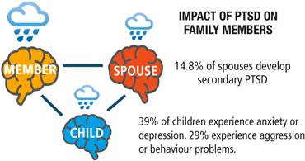
Key Stakeholders
Family members
Spouse
Psychological maltreatment
Mental distress
Children
Depression, Anxiety
Behavioral problem
Notes:
Previous studies have shown that where a parent is experiencing PTSD there can be a concurrent impact on family members which can include psychological maltreatment of spouses, mental distress in spouses, and depression, anxiety and behavioral problems in children.
https://jmvfh.utpjournals.press/doi/full/10.3138/jmvfh.2.2.002

Slide 23
Key Stakeholders
Psychologists and mental health personnel
Shortage
Army is down 20 percent
The Air Force, missing 17 percent
Service members are dealing with the effects of stress
The numbers of service members who need help is expected to grow in the future
Recruit and retain more psychologists
Notes:
According to officials, the Army is down 20 percent from its full complement of 123 psychologists. The Air Force, which is missing 17 percent of its 235 authorized psychologists
due to the shortage in the active-duty psychologist ranks, thousands of service members are dealing with the effects of combat stress.
The numbers of service members who need help is only expected to grow as deployments continue and more service members experience more than one deployment.
To meet the increased needs, the military services want to recruit and retain more psychologists
https://www.apa.org/monitor/sep07/transforming.aspx

Slide 24
Information Collection
General mental health survey
An investigation for mental status of service members during basic military training
Provide basic information for intervention design

Slide 25
Financial Resources
Government
Department of Defense
As part of the defense budget
Department Of Veterans Affairs
Other organizations
Military OneSource
Department of Defense-funded program
American Psychological Association
Push to secure military mental health funds
Notes:
There are financial resources available for active members provided by both the government and outside organizations.
The main funding support may come from the Department of Defense as part of the defense budget.
Military OneSource is a Department of Defense-funded program that provides educational materials on every aspect of military life at no cost to active duty members.
Sometimes, APA also push to secure more military mental health funds to support a new training initiative
https://www.stripes.com/news/house-passes-new-mental-health-screening-for-recruits-1.284738
https://www.foxbusiness.com/features/4-financial-resources-for-active-military

Slide 26
Feasibility of the Intervention
•New waivers policy enacted in August 2017
–A history of “self-mutilation”
–Bipolar disorder
–Depression
–Drug and alcohol abuse
•All need mental health support
–Reduce the high suicide rate
–Improve the quality of life
Notes:
People with a history of “self-mutilation,” bipolar disorder, depression and drug and alcohol abuse can now seek waivers to join the Army under an policy enacted in August in 2017.
But accepting recruits with those mental health conditions in their past carries risks. Because people with a history of mental health problems are more likely to have those issues resurface than those who do not.
Therefore, either those with diagnoses before they enter the armed forces or those who develop mental health conditions after, they all need mental health support
https://www.usatoday.com/story/news/politics/2017/11/12/army-lifts-ban-recruits-history-self-mutilation-other-mental-health-issues/853131001/

Slide 27
Development of Veteran and Active Duty Military Men and Women Mental Health Program
Goals:
Repurpose the existing mental health program established by the DOD/DHS to maximize budget and save funds
Create a strong non-bias awareness at the beginning of the military career
Reduce PTSD and suicide rates in the military and veterans
Development:
Class seminars - to include recognition of mental health issues and encourage seeking of help
Case study reviews - to reiterate early detection and prevention benefits
Mental health program at initial entry (recruits)
Hour courses - presentations with material based off of existing program, active military personnel who have been helped by early intervention
Bi-weekly

Slide 28
Framework
Continue through military career to reiterate importance of mental health
Annual training (online or via classroom)
Case scenarios/published studies with stats - with and without interventions
Peer group - with therapists to maintain comfortability with clinicians
Hand-off to VA
Mental health evaluations
Medical records - flagged
Tele-conference/consult/follow-up

Slide 29
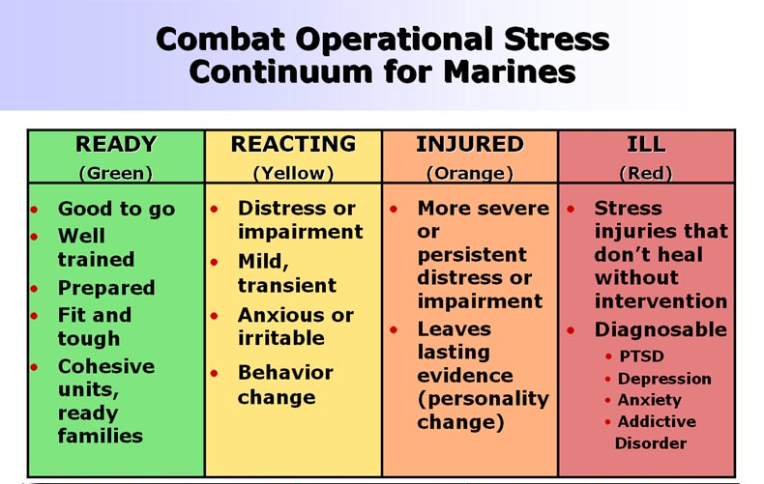
Dissemination
Mental health training will be required
Green/Amber/Red
Deployable vs non-deployable
Screening Forms
Mental Health Professionals

Slide 30
Financing
Financial Cost:
$78,000,000 in salaries to psychologists
Average annual salary of psychologists working Military: 60,000
Projected number of psychologists: 1,300 (1 psychologist: 1000 active duty service men and women)
Important to note that not all of these individuals would be new hires, part of responsibility would be absorbed by psychologists currently working for the military (the Army alone employs 600 phycologists)
$19,667,960 in salaries to administrative assistants
Average annual salary of administrative assistants working for Military: 37,823
Projected number of administrative assistants needed: 520 (1 administrative assistant: 2500 active duty service men and women)
$500,000 in miscellaneous costs (training the instructors, online sessions, training space, etc)
Implement interventions to improve the health of the population
Start at all DOD/DHS recruit training facilities and academies
Establish annual mandated training
Establish annual mental health risk assessments
Suggest a bonus after completing the survey ($50 increase to paycheck for 1 pay period)

Slide 31
Resources for Policy and Program
Presentations from DOD/DHS
Training of personnel to recognize signs of mental health problems
Therapists on site
Stress reduction method education (ie: meditation and benefits)
Emotional support animals/quiet sanctuaries
Encouragement of “Buddy Care”, a friend among peers to confide in/engage in stress reducing activities with/someone to recognize warning signs
Understanding available resources/how to access them
Periodic reiteration of resources and warning signs
Reiteration of belonging to a group, part of a family
Group support session/services

Slide 32
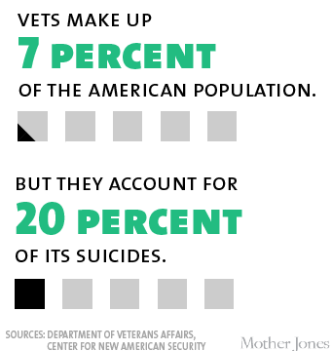

Slide 33
Veteran and Active Duty Military Men and Women Mental Health Program: Recap
Lorem 2
Active Duty Service Men and Women
Lorem 3
Lorem 1
Veterans
New Recruits
Mandatory mental health program provided to all new recruits as part of basic training
Mandatory annual mental health sessions/screenings provided to all active duty men and women
Improved hand off to VA care with special focus on increasing awareness and early identification of mental illnesses

Slide 34
Evaluation
Evaluations will be conducted at three different stages of program development:
Start Date
Six Months
Year 1
Year 2
Planning
Implementation
Effects
Effects
Goal: Refine plans
Goal: Improve operations
Goal: Identify effects
Notes:
Planning - the goal of evaluation is to refine plans. Done before program begins
Implementation - the goal of evaluation is to characterize real, as opposed to ideal, program activities and to improve operations, perhaps by revising plans.
Effects - the goal of evaluation is to identify and account for both intended and unintended effects.

Slide 35
Initial Evaluation
Focus groups involving:
Psychologists - identify what they need to run effective initial and ongoing mental health sessions
Department of Defense - identify any resistance to the program and barriers to financing the program
Veterans Affairs - identify gaps in mental health record transfer
Service men and women - identify key concerns and goals
Families of service men and women - identify key concerns and goals
Notes:
Planning - the goal of evaluation is to refine plans.
Notice barriers before implementation

Slide 36
Implementation Evaluation
Measure the attendance and functioning of each aspect of the program
Initial recruit mental health session
Require attendance be taken at every initial session and calculate percentage of new recruits that participated
Surveys to recruits - given at the end of initial session
Surveys to psychologists - given to each therapist at the end of the first six months
Ongoing mental health sessions
Require attendance be taken at every ongoing session and calculate percentage of soldiers that participated
Surveys to soldiers - given at the end of of the first six months
Surveys to psychologists - given to each therapist at the end of the first six months
Hand off to VA
Surveys to receiving VA clinicians
Notes:
Implementation - the goal of evaluation is to characterize real, as opposed to ideal, program activities and to improve operations, perhaps by revising plans.
Surveys to recruits - given at the end of initial session, questions on thoughts about initial session
Surveys to soldiers - given at the end of of the first six months, questions on thoughts about program
Surveys to receiving VA clinicians, questions regarding ease of record transfer and ability to quickly identify soldiers suffering from mental illnesses based on records alone

Slide 37
Effects Evaluation
Measure outcomes of program
Incidence of PTSD reported in service men and women and incidence of suicide
Compare with incidence in year prior to program implementation and compare results year after year
Early identification of mental illness in veterans by the VA
Compare average time between PTSD diagnosis and discharge
Support for mental health illness
Focus groups and individual interviews for service men and women, veterans and their families
Notes:
Effects - the goal of evaluation is to identify and account for both intended and unintended effects.
Incidence rates year after year - will help determine if program is making continous progress or if it stalls and needs to be modified

Slide 38
Possible Areas for Improvement
If our results from any of the evaluations show that we are unsuccessful or at risk of being unsuccessful the program will be modified. Possible areas of concern are:
Lack of support from soldiers, particularly new recruits
Too many or too few mental health sessions
Ineffective online annual training sessions
Funding
Notes:
Lack of support from soldiers, particularly new recruits - mental health still has a large stigma attached to it, recruits may be unreceptive to mandatory mental health sessions. Hopefully this would be identified in the initial evaluation. If it is seen to be the case, the session can be rebranded as a “wellness” session or bonuses could be given to participating individuals
Too many or too few mental health sessions - more likely to be too few, we will increase the number of sessions if necessary
Ineffective online annual training sessions - possible that an online session will not garner the attention necessary for such sensitive topics, if this is the case we will move all sessions to the in person format
Funding - possible lack of funds, will increase the ratio of participants to therapists to contain costs

Slide 39
Maintenance - Funding
Given our estimated annual costs for psychologists, administrators and miscellaneous the total annual cost is expected to be $98,167,960
Miscellaneous costs will decrease over time
Possibility of reducing number of psychologists and administrators as well
This proposed budget only constitutes a small fraction of current mental health services budget and spending
2019 VA budget submission requests 8.6 billion for Veterans mental health services
By 2020 budget request will rise to 9.1 billion
Between 2007 and 2012 4 billion was spent on mental disorder treatments for active duty servicemen and women
Program will save money in other areas
Preventative care costs versus treatment costs
Lost productivity and wages
Notes:
Therefore, while this program may seem expensive it will represent just a small fraction of what is spent on mental illness in the military and it will lead to total mental illness spending to decrease

Slide 40
Maintenance - Public Support
Public Awareness Campaigns
Results publicized
Bipartisan support - past two years military budgets were approved
Notes:
Public Awareness Campaigns - ensure general public knows of the importance of mental health in service men and women
Results publicized - report successes
Bipartisan support - viability of a government program is determined by broad support from both parties. Past 2 budgets were passed with bipartisan support, FY19 had an 82 billion dollar increase

Slide 41
References
https://www.ptsd.va.gov/understand/what/ptsd_basics.asp
https://www.ptsd.va.gov/understand/common/common_veterans.asp
https://www.va.gov/opa/docs/Suicide-Data-Report-2012-final.pdf
https://academic.oup.com/epirev/article/37/1/144/423274
http://citeseerx.ist.psu.edu/viewdoc/download?doi=10.1.1.858.1800&rep=rep1&type=pdf
https://www.apa.org/monitor/sep07/transforming.aspx
https://www.mentalhealthfirstaid.org/cs/wp-content/uploads/2014/04/Veterans-MHFA-Fact-Sheet.pdf
https://www.military.com/education/keys-to-success/tips-for-stress-management.html
Suicide Intervention Skills training for Leaders DOD.pdf
https://www.cdc.gov/mmwr/PDF/rr/rr4811.pdfCdc-pdf
https://www.va.gov/budget/docs/summary/fy2019VAbudgetInBrief.pdf
https://www.nextgov.com/cio-briefing/2013/08/pentagon-spent-nearly-1-billion-mental-health-treatment-2012/69194/
https://www.psychologycareercenter.org/army-psychologist-salary.html
https://www.apa.org/gradpsych/2011/01/service.aspx
https://www.forbes.com/sites/eriksherman/2018/06/20/house-and-senate-democrats-vote-68-percent-and-85-percent-for-massive-military-spending/#262277fc5101

